Slide 1

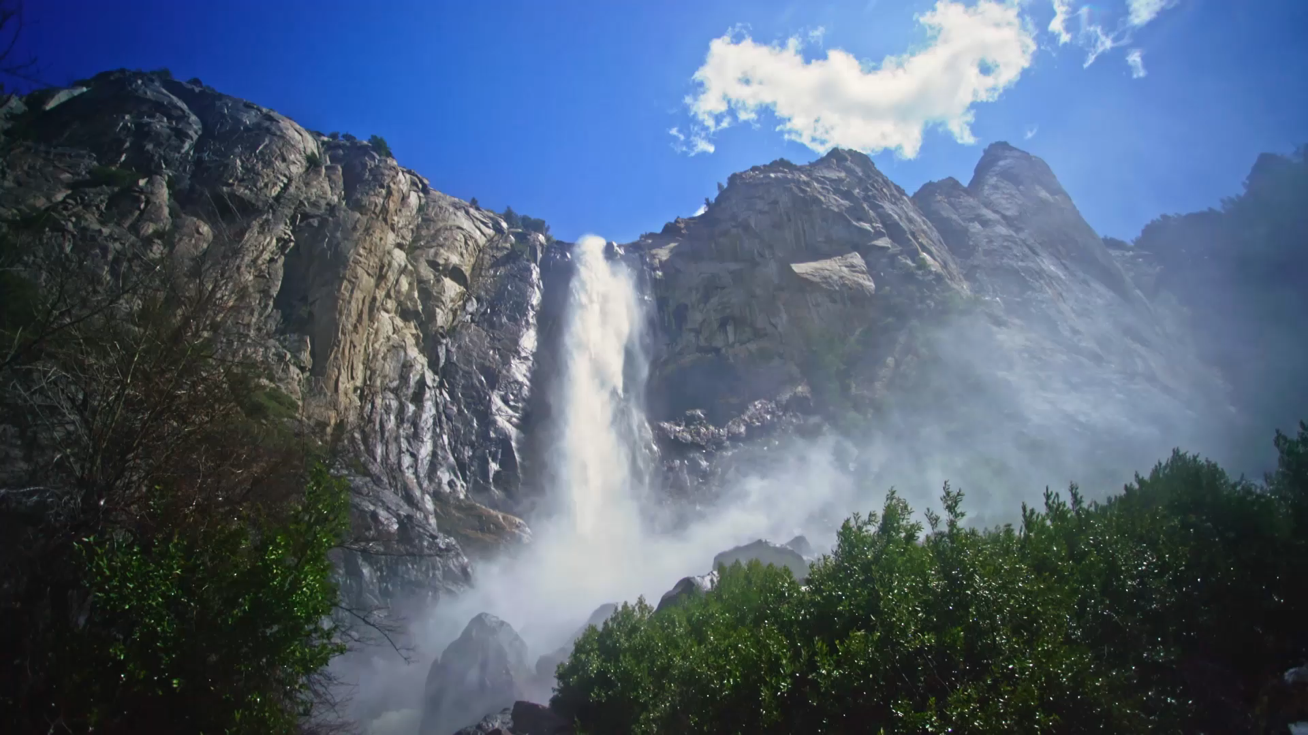
Project 1: Image classification using feed forward neural network
-Arunkumar Ramachandran –Course Instructor: Dr. Ryan White
-Student ID: 903928488 –Course Code: MTH 5320

Slide 2
Contents
Introduction
Goal
Dataset Used
Preprocessing Data
Resizing Image
Weight Initialization Method
Network Architecture
Activation Function
Tune Hyperparameters
Best values obtained after tuning
Final Code
Discussion

Slide 3
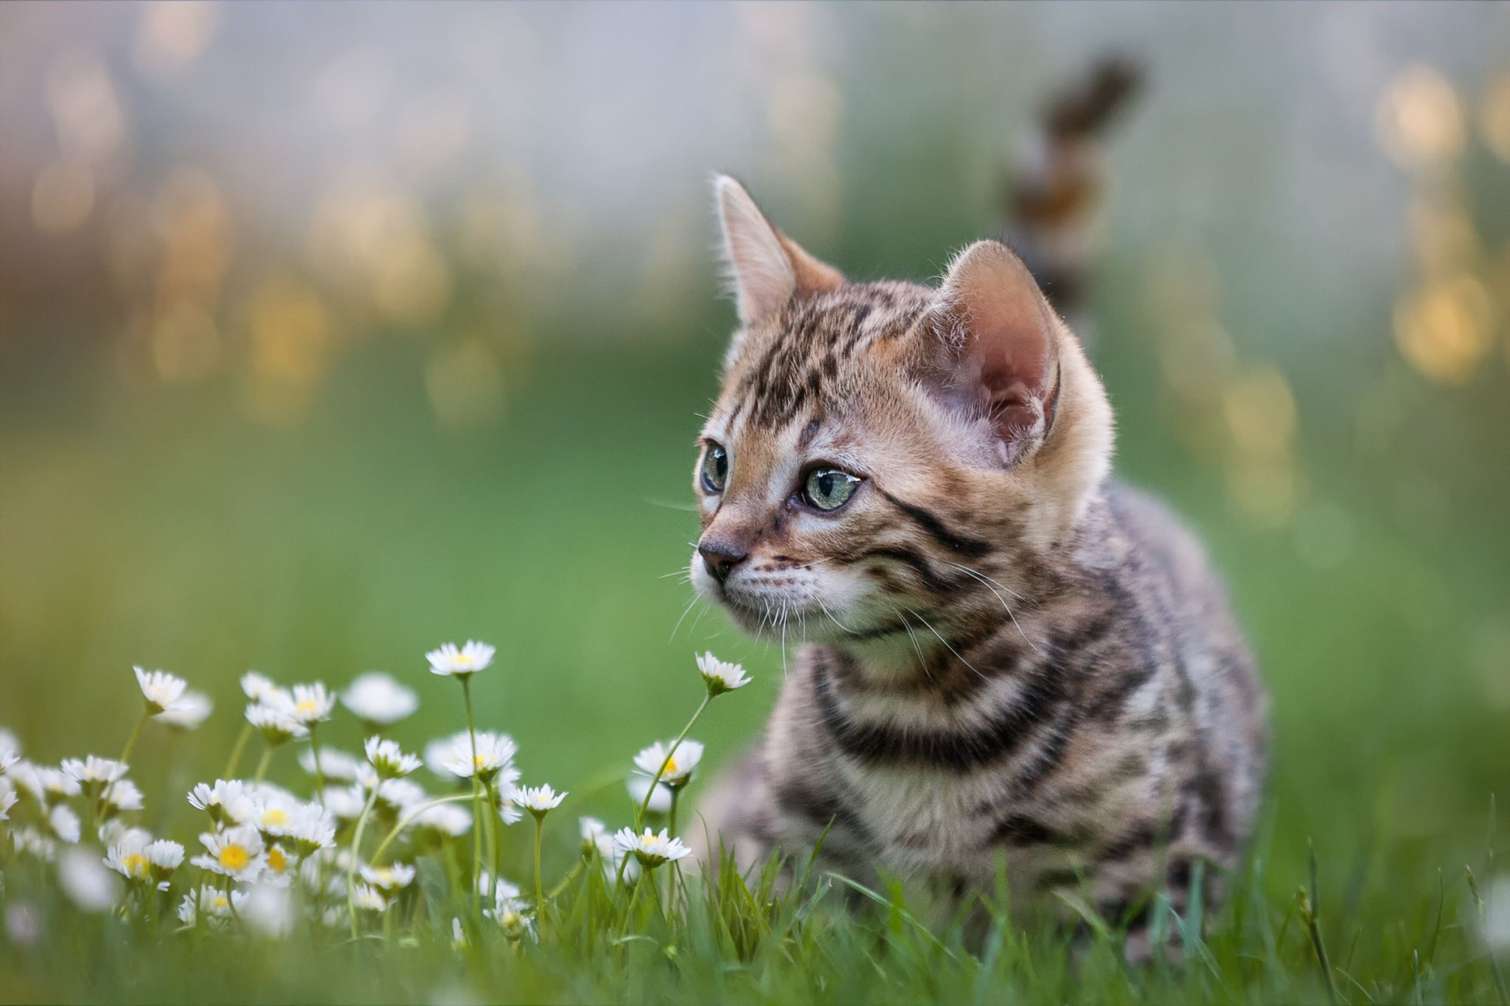
Introduction
Image recognition refers to the task of inputting an image into a neural network and classifying that image to its respective labels.
?
Image classification according to the label

Slide 4
Goal
The main goal of this project is to classify scenery images according to their respective labels and train the model to obtain good accuracy.

Slide 5
Dataset used
Initially, the following dataset is used as shown in the image below:
https://www.kaggle.com/puneet6060/intel-image-classification
In this project, six labels are present. They are:
Glaciers
Buildings
Forest
Sea
Mountain
Street
This Data contains around 25k images of size 150x150 distributed under 6 categories.
There are around 14k images in Train and 3k in Test.

Slide 6
Preprocessing Data
In this project, two normalization methods were used. The two normalization methods used are:
Sklearn. preprocessing. normalize function
Min-Max Function
Out of the two, normalize function produced a higher accuracy.

Slide 7
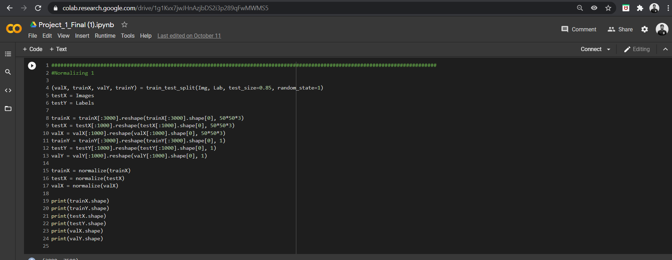

Slide 8
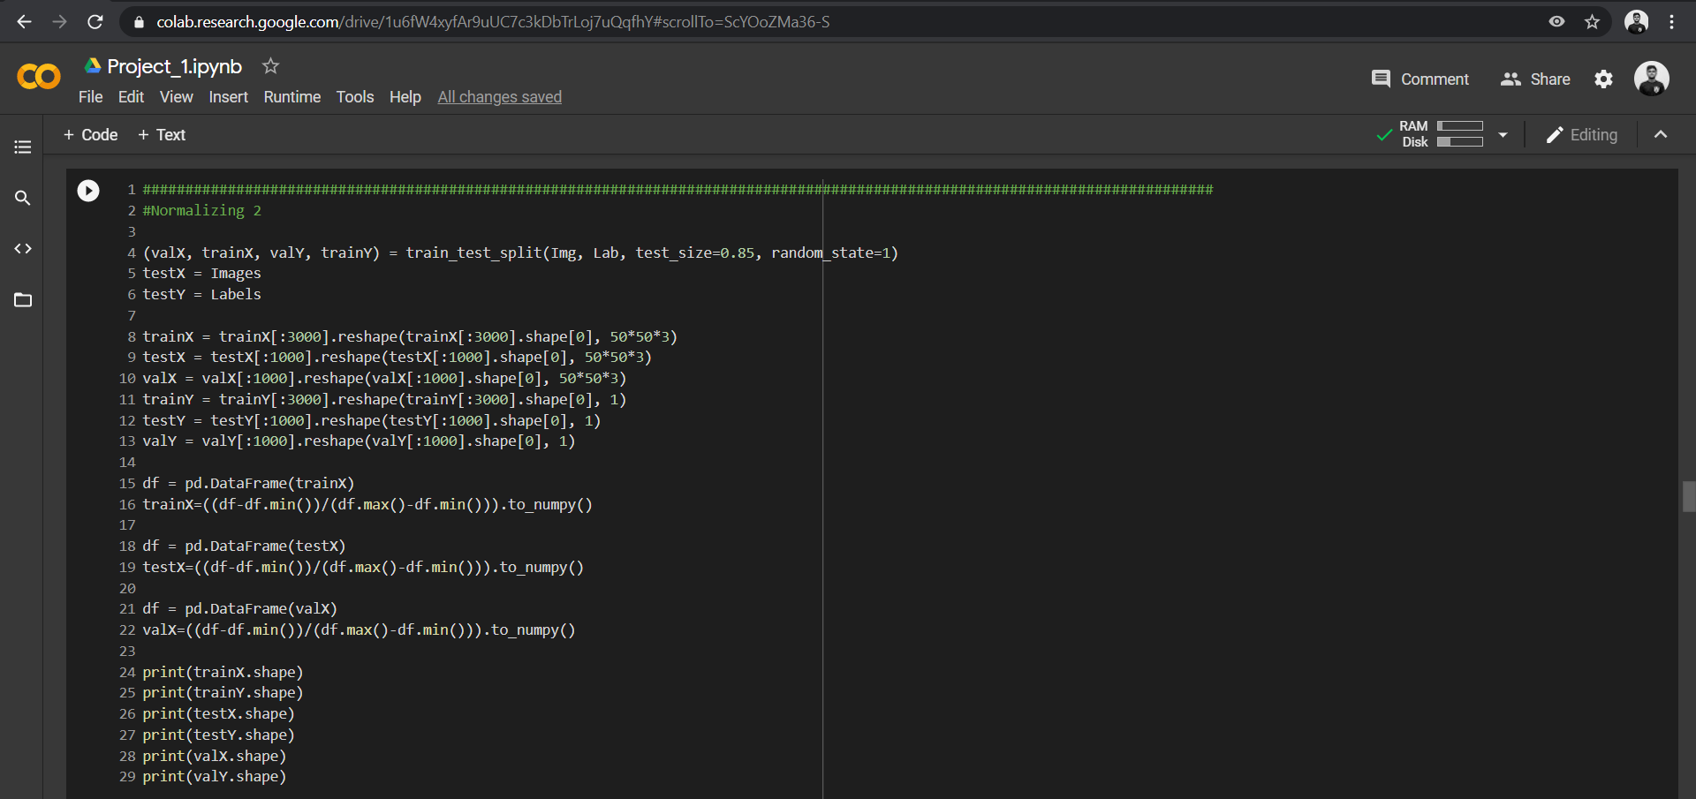

Slide 9
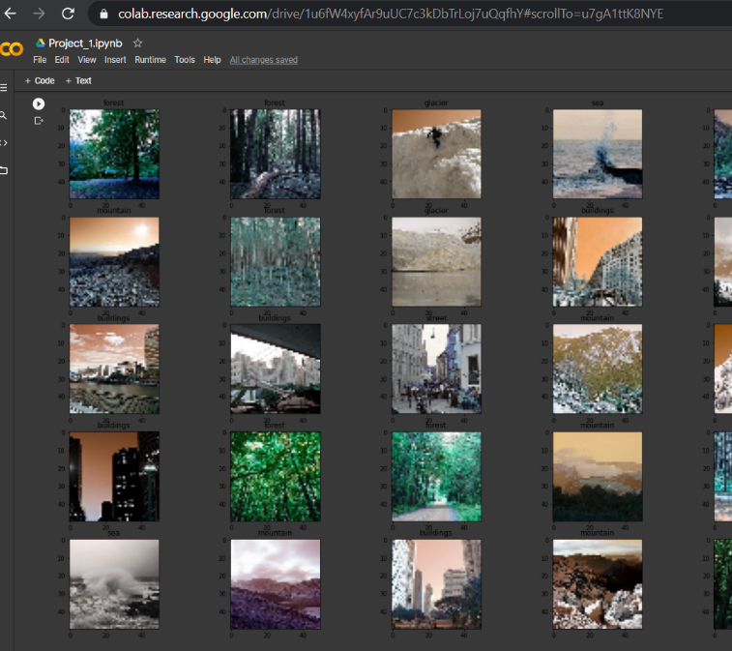
Visualization of train data images after resizing
The images are of BGR format.

Slide 10
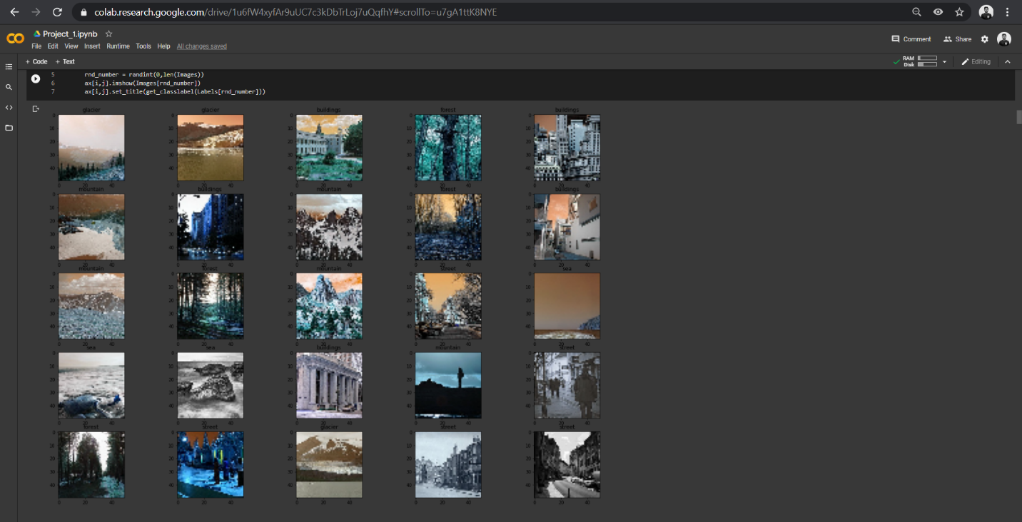
Visualization of the test set images after resizing
The images contained in the train and test dataset have been resized from (152*152*3) to (50*50*3).
The image on the right is of the Test Data.

Slide 11
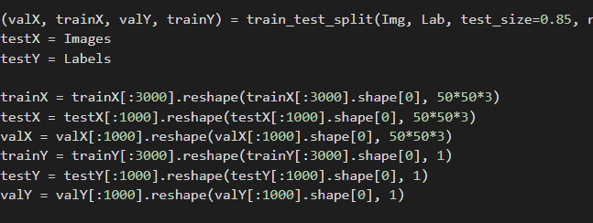
Initially to tune the hyperparameters, the following data was used:

Slide 12
Weight Initialization method
Different weight initialization methods were used, and the one that gave the best accuracy was selected to tune the hyperparameters.
The weight initialization methods used are shown in the following:
Normal
Uniform
Lecum
Glorot
Among these, Glorot showed better accuracy than the rest, and hence it was selected to tune the hyperparameters.

Slide 13
Network Architecture
Three Network architectures were used before tuning the hyperparameters. They are as follows:
Network Archi1 = [(50*50*3), 62, 62, 6] ## (50*50*3) input, (62, 62 )Two hidden layers, (6)one output
Network Archi2 = [(50*50*3), 64, 32, 18,6] ## (50*50*3)One input, (64, 32, 18)Three hidden layers,(6) one output
Network Archi3 = [(50*50*3), 64, 32, 42,52,6] ##(50*50*3)One input, (64, 32, 42,52)Four hidden layers,(6) one output

Slide 14
Activation Functions
The activation function used in this project are as follows:
ELU
ReLU
Sigmoid
Amongst these, ReLU, along with Glorat, showed better accuracy than the other two activation functions.

Slide 15
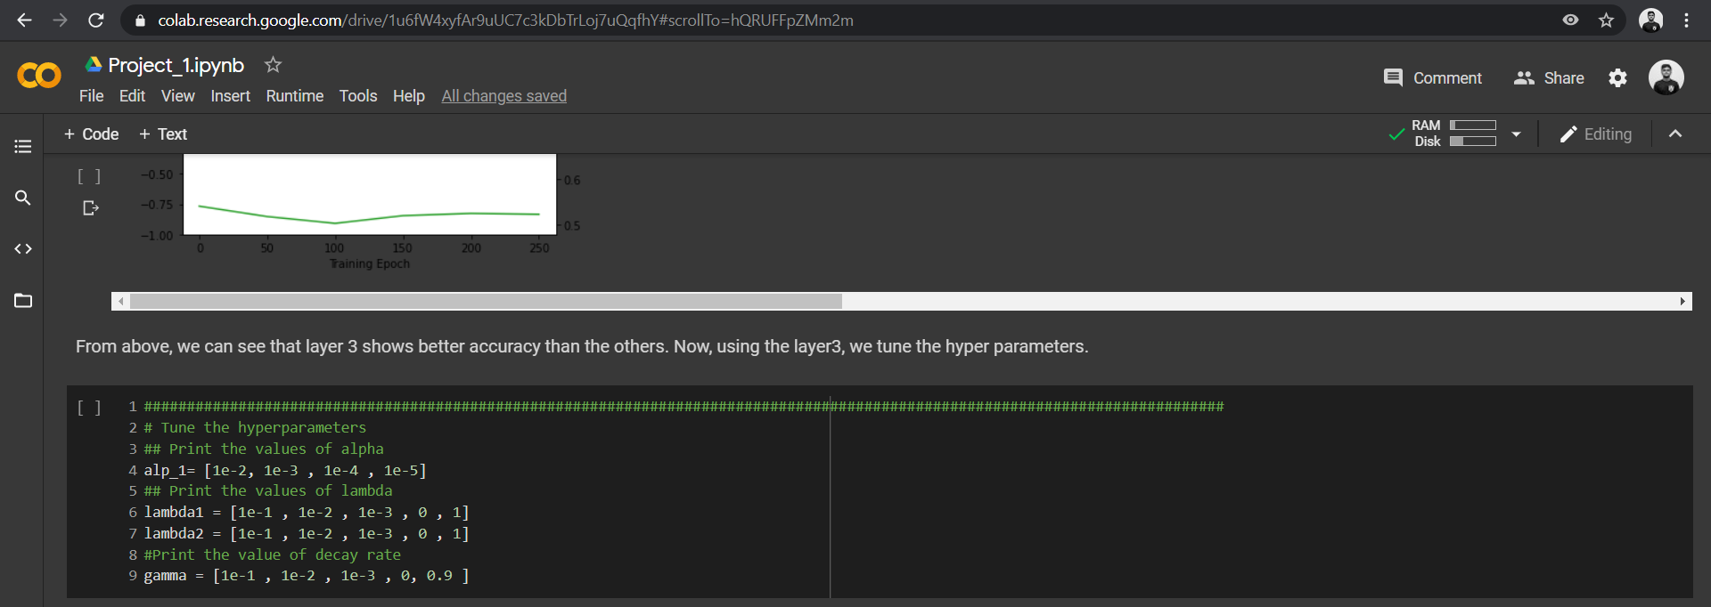
Tune hyperparameters
After selecting the right activation and weight initialization method, the hyperparameters were tuned. To tune the hyperparameters, specific values for lambda1, lambda2, alpha, and gamma were given to choose the best one out of these values depending on the accuracy they printed. Random values were given and the best values depending on the accuracy they produced were considered.

Slide 16
Best Values:
Lambda 1 | 0.1
Lambda 2 | 0.01
Alpha | 0.001
Gamma | 0

Slide 17
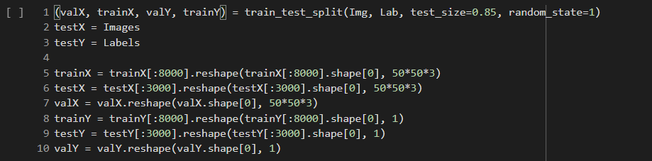
Final Model Training
By using the best values obtained after tuning the hyperparameters, the final model is trained by sending more dataset values. The dataset values used can be shown in the following image.

Slide 18
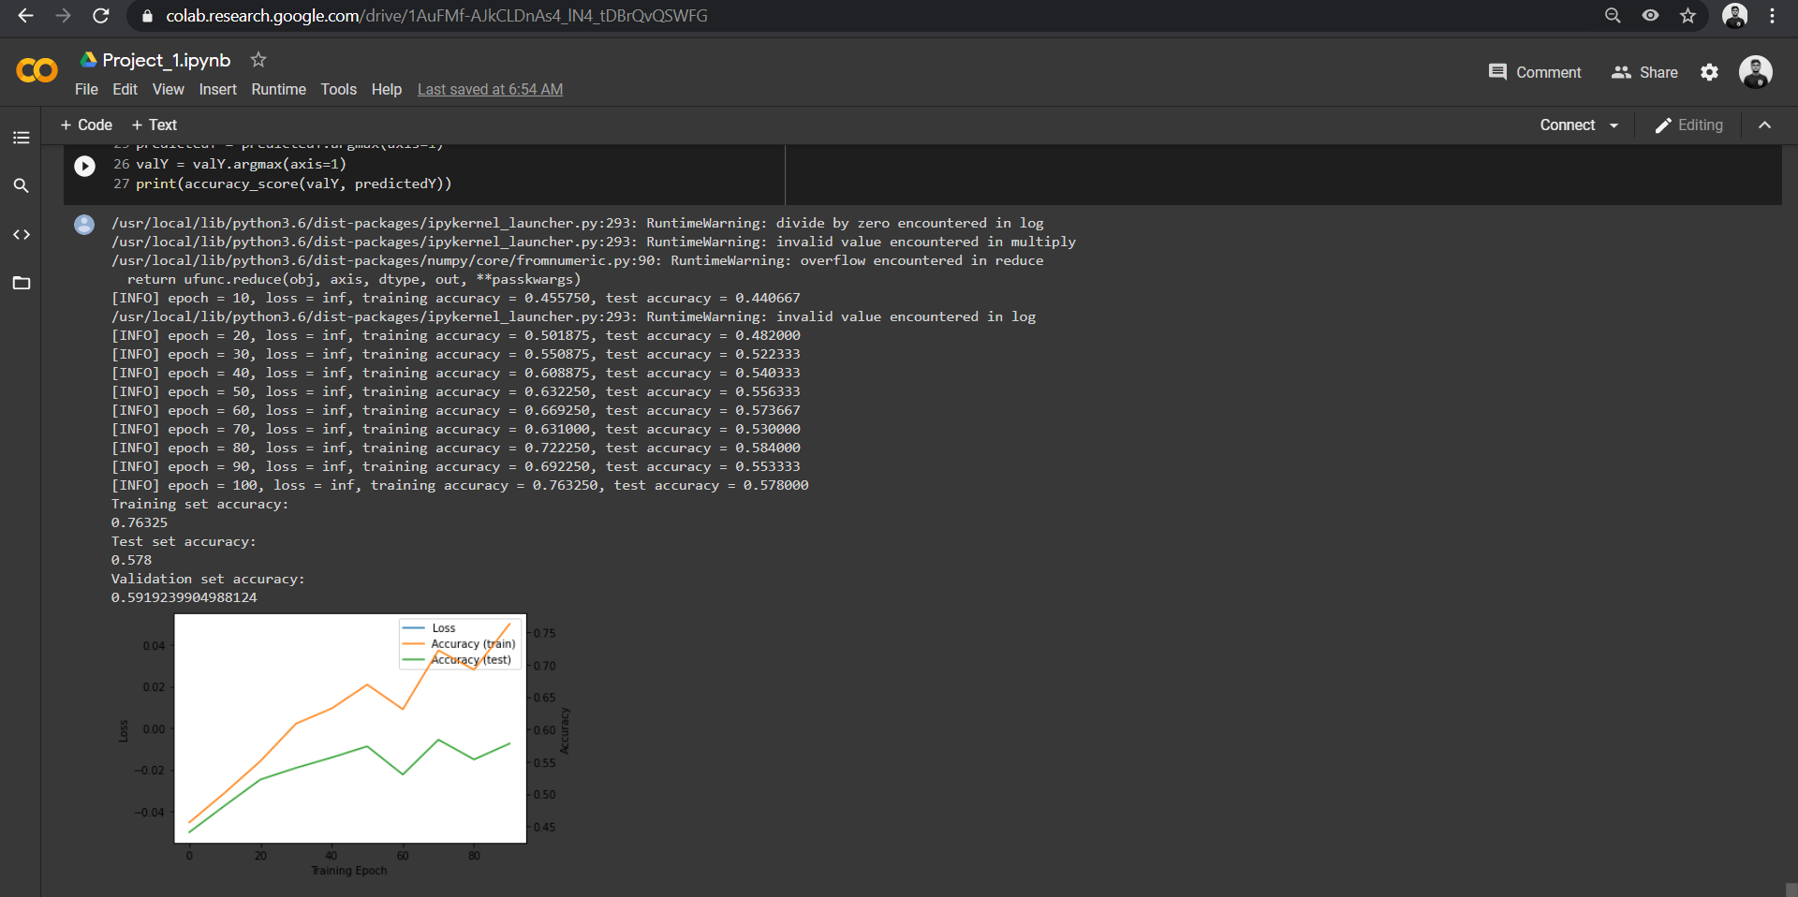
The accuracy obtained :
Train set – 0.76
Test set – 0.578
Validation Set – 0.591
The images of my final model can be shown in the following image:

Slide 19
Discussion
As seen above, the accuracy values touched 58 percent. This maybe because of using feed-forward neural network architecture. By using a better deep neural network such as CNN, there may be a chance to improve our accuracy values than the ones obtained above.
CNN helps in classifying images automatically by detecting the important features without any human supervision and hence it is an ideal choice for image classification.

